Slide 1
DIGITAL PORTFILO
STUDENT name :R. SHARMINA RESTRICT NUMBER AND NM ID: 2422k1266 DEPARTMENT :Computer science College and university : maharani Arts & science college bharathiaruniversity

Slide 2

PROJECT TITLE
SOFTWARE ENGINEER

Slide 3
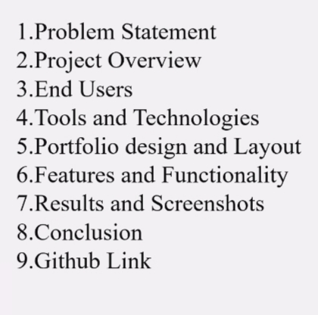

AGENDA

Slide 4

PROBLEM STATEMENT
Software engineer is the on best communication Tool. Clear this description of user or Business Pain Point the needs for Problem solving , desired future State , gap between them With out defined solution.

Slide 5
PROJECT OVERVIEW
*What you Software engineer portfolio in Contains (About me, skills, project, and Contact section ). *Main idea about for project clear and simple, skills and design.

Slide 6
WHO ARE THE END USER
* Information people access are gathered in the World. * Students ( improved communication and World wide connect). * People is help ( digital marketing, are online payment banking, for example in g pay, phone pay). *job seekers are applicant ( to share with resume building used).

Slide 7

TOOLS AND TECHNIQUES
• HTML ->structure (pages, Section). • CSS -> Styling (colours,layout, responsiveness ). • JAVA SCRIPT ->Interactive( navigation menu , animation , form validation ). *mention is code editor CODEPEN is hosting platform( GitHub pages).

Slide 8
PORTFOLIO DESIGN AND LAYOUT
• Section included : • Home / About Me • Project • Skills •Contact

Slide 9
FEATURES AND FUNCTIONALITY
• Navigation Bar With smooth scrolling. • Project Showcase with images/ideas. •contact form(with validation).

Slide 10
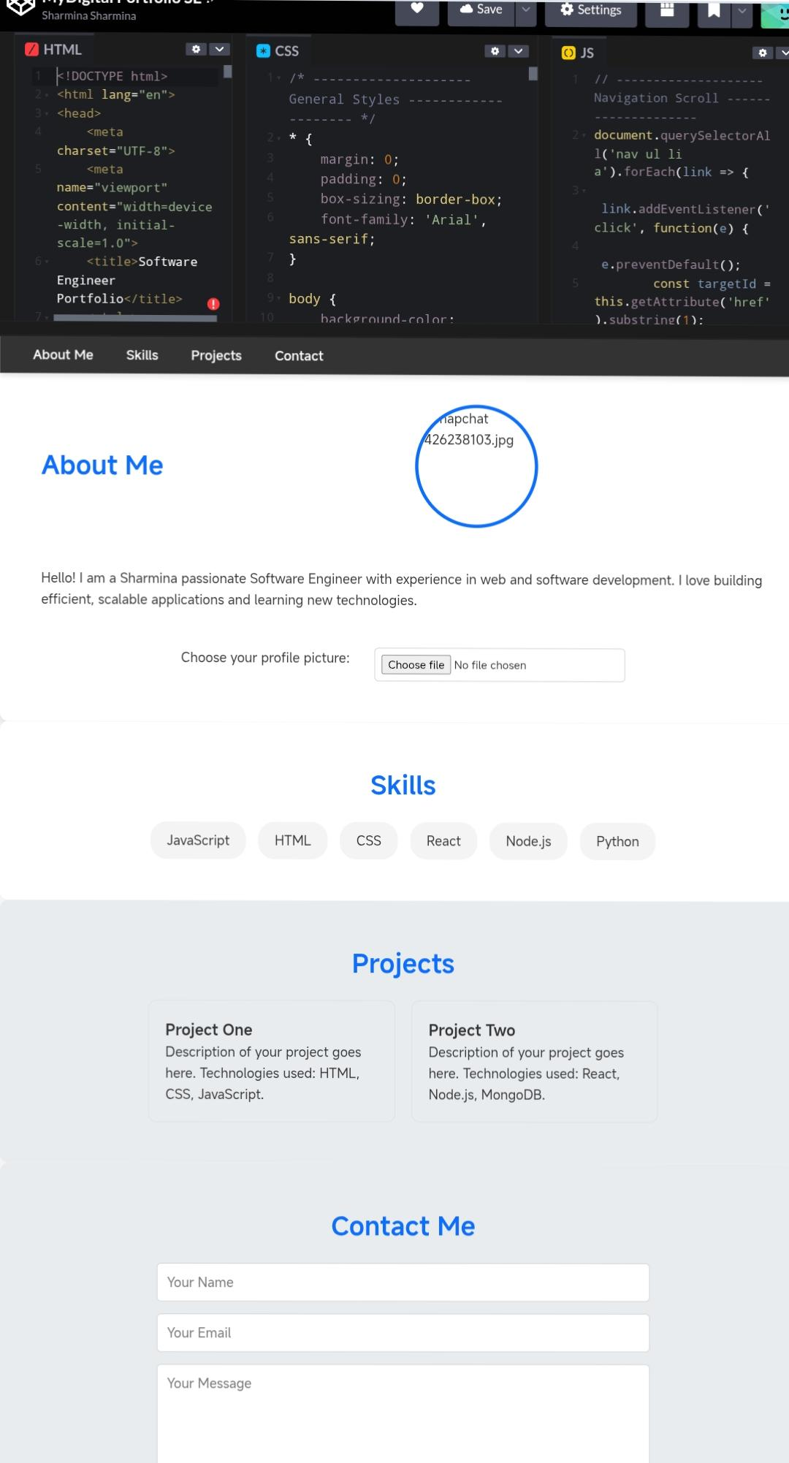
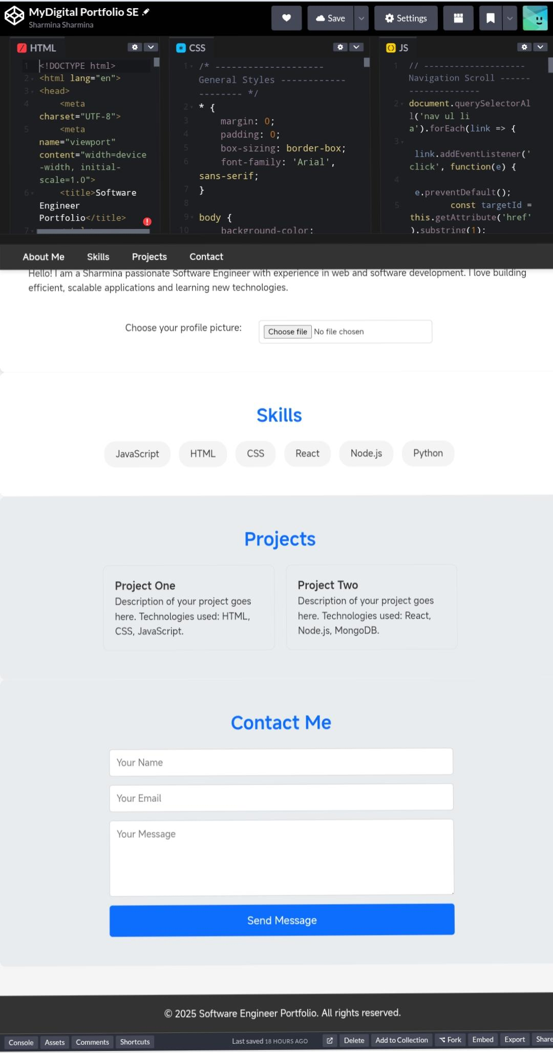
RESULT AND SCREENSHOTS

Slide 11
CONCLUSION
* Software engineer is the best and people very used this concept.
Student recap in the project overall significance and value.
Provide a final thought or recommendation for future projects.

